Slide 1

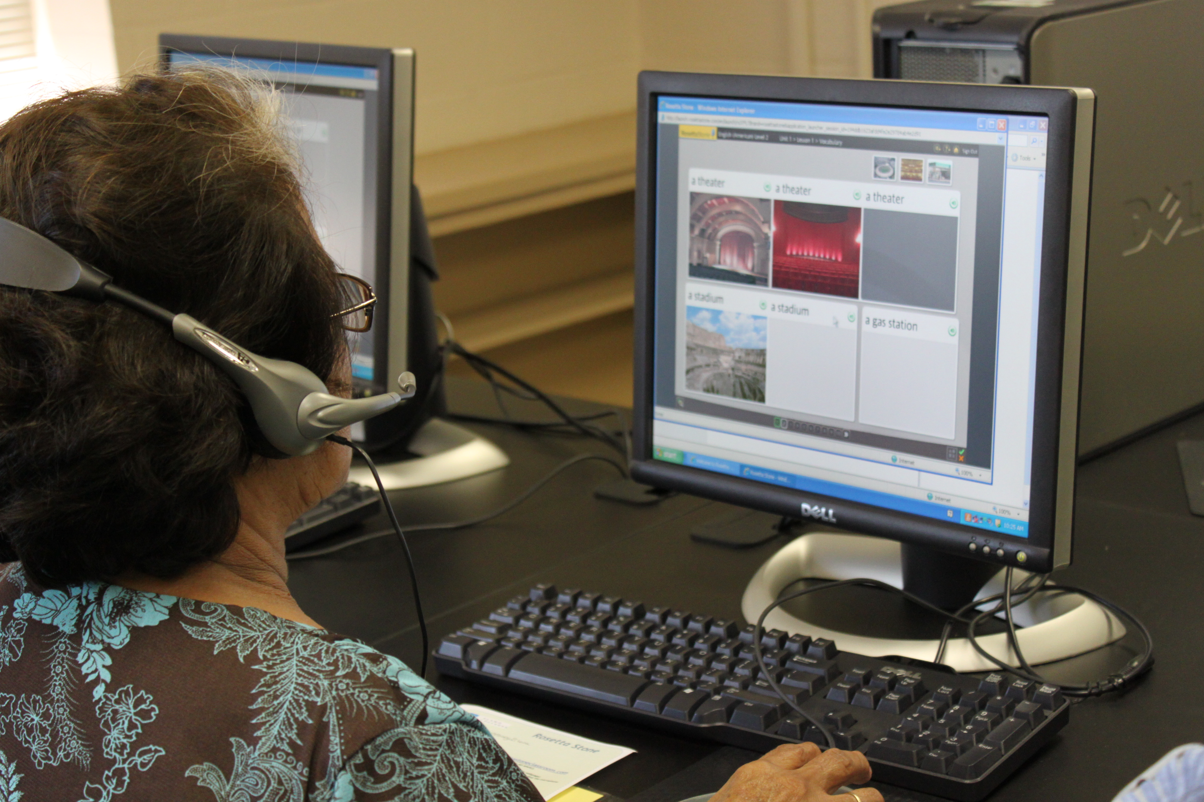
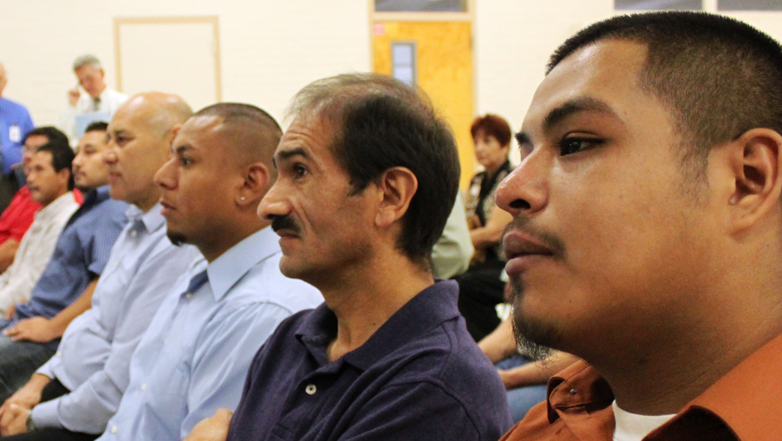
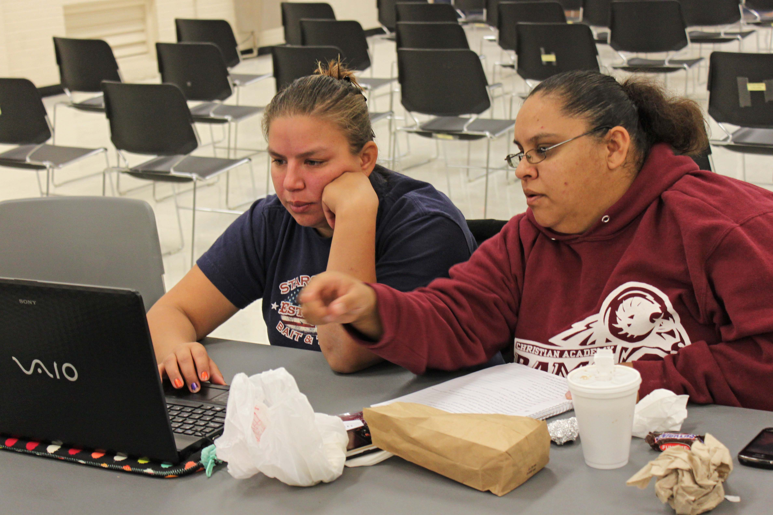
2016 September AEL Business Meeting 2016 – PD Coordinators
TRAIN PD @ TCALL

Slide 2
AGENDA
Time | Topic
8:30 – 10:00 | Welcome, Overview of TRAIN Tex Model, Begin Unpacking
10:00 – 10:15 | Break
10:15 – 11:00 | Unpacking PD Grant-specific Requirements
11:00 – 11:30 | State of the State – Business Meeting
11:30 – 1:00 | Lunch on your own
1:00 – 2:30 | Unpacking PD Grant-specific Requirements
2:30 – 2:45 | Break
2:45 – 4:30 | Unpacking PD Grant-specific Requirements

Slide 3

Review of the TX PD Model – TRAIN Tex
Region 6
TRAIN PD @ TCALL
Notes:
Lori and John to do overview, then we do PD Center

Slide 4
TRAIN PD @ TCALL

Slide 5
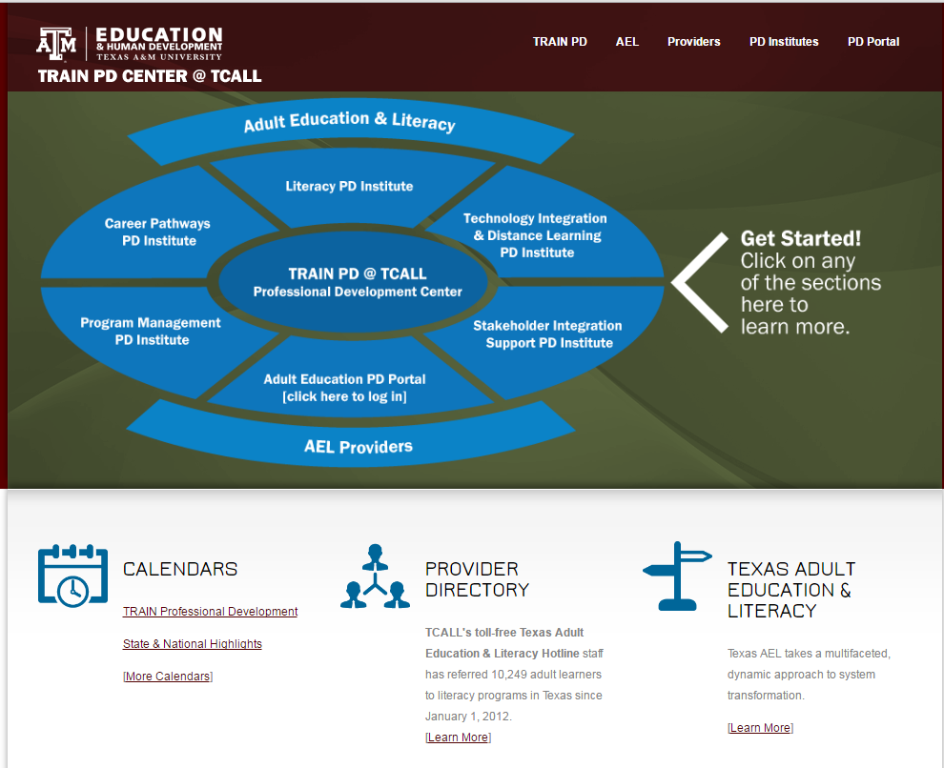
The New Website
Notes:
Bring in New Webpage
Talk about Institutes – What does an Institute include?
One day symposium
Training of Trainer event
Creation of new content (both F2F and online) as needed
Helpful Weblinks on the Institute page
How they are identified in the PD Portal
Connect Communities of Practice – PLN

Slide 6
Before we begin…
Any alterations, additions, or deletions to the terms of this grant award required by changes in federal or state law or by regulations are automatically incorporated into this grant award without written amendment hereto, and shall become effective on the date designated by such law or regulation
Notes:
Lori’s email content:
Standard TWC/AEL contract language that is contained in the General Terms and Conditions section of the contract.
This is the statement in all of the contracts in the general terms and conditions (GTC) and requires that any changes in the rules or laws are automatically incorporated into the grant requirements; i.e., the new staff qualifications and training at 40 TAC 805.21 automatically replace the staff qualifications and training section in the contracts. The new staff qualifications and training requirements for AEL grantees was officially effective July 1, 2016. At this time, we do not know if an official amendment will be processed to change the language in existing contracts.

Slide 7
Unpacking PD Grant-specific Requirements
Bottom Line:
MUST have a PD Coordinator at the minimum of 20% FTE
5.6.16 Professional Development. The Grantee shall provide Professional Development (PD) as outlined below and described in the Texas Adult Education Professional Development and Program Support System that may be found on the Agency’s AEL website http://www-tcall.tamu.edu/twcael/pdi.htm . At the discretion of the Commission, additional funds may be provided for PD in subsequent years.
  5.6.16.1 Utilizing state leadership funds, the Grantee must propose the number of staff and percentage of time dedicated to the delivery of PD services, including the services of a Local PD Coordinator. The Grantee must fund, at a minimum, the equivalent of a twenty percent (20%) Full Time Equivalent staff member to act as the Local PD Coordinator to deliver PD services to the AEL Program.
Notes:
Bottom Line:
MUST have a PD Coordinator at the minimum of 20% FTE
This means that, for a typical 40 hour workweek of a full-time employee, at least 8 hours, or 1 full day, is spent on professional development activities: this could be entering PD hours into TEAMs, evaluating TEAMS data to identify PD needs, setting up a training request with your PD Specialist, or conferencing with your Program Director on the PD needs of your program. These are examples and not a comprehensive list of PD Coordinator duties.

Slide 8
Unpacking PD Grant-specific Requirements
  5.6.16.1.1 The Local PD Coordinator shall not be the Director of the Grantee.
  5.6.16.1.2 The Local PD Coordinator serves as the Grantee’s PD point of contact for the Agency and the PD Center.
  5.6.16.1.3 The Local PD Coordinator shall collaborate with their assigned PD Center Specialist, AEL Program Director, and Agency staff as necessary to ensure that PD needs of the Grantee are met.
Notes:
Let’s step back now and talk about your support system.
The PD Coordinator job is critical to identifying program improvements that can be made through professional development, ensuring that the appropriate PD has been provided to the correct staff, within the correct time frames, and has been entered timely. All data entered into TEAMS is required to be entered at least on a monthly basis, and is certified as accurate when the Program Director signs off on the data in TEAMS each month.
Hand out Contact List
Introduce PD Specialists and TWC Program Specialists
Let’s differentiate between the two roles – Handout Roles and Responsibilities

Slide 9
Tier 1 Training
Tier 1 training includes the following:
Student Intake
Career Awareness
Numeracy Instruction
1 & 2 only

Slide 10
The PD Coordinator must be a full time job.
True
False

Slide 11
Which of the following topics is covered in the TRAIN PD Institutes?
Distance Learning
Fishing for Dummies
Career Pathways
Literacy Instruction
#1,3 & 4 only

Slide 12
Unpacking PD Grant-specific Requirements
Quiz – what day is the revision due?
  5.6.16.1.4 The Local PD Coordinator shall coordinate PD planning, implementation, and documentation:
    5.6.16.1.4.1 the Local PD Coordinator shall work with their assigned PD Center Specialist and AEL Program Director to develop the Grantee’s strategic PD plan for continuous improvement;
Notes:
Any guidance from Lori on the revision of the CIP. Lori asks group some questions.
Do you know how important this document is to the performance of your program? Lori explain why this planning tool was developed, what is encompasses, and how it is the basis for the movement of the program, why there is a revision; the importance of understanding how to review your data and plan.
Lori Questions:
How many used the PD/CIP form with a budget, and how many used the form with a budget? Why did you make the choice you made? Will you change your choice this year, or did you prefer the one you used last time, why?
Are you involved with the portion of your program’s budget that is allocated for PD activities?
Do you work directly with the Program Director in assessing and addressing PD needs for your program? If not, with whom do you coordinate? Are you responsible for informing staff when they need a certain type of PD? If PD requirements are not met by the end of the program year, staff are not eligible to work again until their PD requirements have been met. Who notifies staff that they have not met their PD requirements? How are they notified, and when are they notified.

Slide 13
Unpacking cont.
  5.6.16.1.4 The Local PD Coordinator shall coordinate PD planning, implementation, and documentation:
    5.6.16.1.4.2 the Local PD Coordinator shall submit contextualized and/or Specialized Curriculum developed by the local AEL program to the PD Center for review and inclusion as an available resource for other AEL programs; and
    5.6.16.1.4.3 in the event that the Grantee is placed on an AEL Technical Assistance Plan, the Local PD Coordinator shall coordinate PD planning, implementation, and documentation as directed by the Agency.
Notes:
Lori can address: this portion of the requirements states that any existing curriculum that is contextualized to accommodate a particular training or classroom instruction agenda, and any curriculum for which the content has been developed by the AEL program, shall be submitted to TRAIN PD (the PD Center) to review for accuracy and consistency, as well as inclusion to the TRAIN PD resource collection to be made available to other AEL programs. This includes any curriculum that is developed for the provision of local PD; curriculum development should be coordinated with your PD Specialist. PD hours for specific requirements, such as “principles of adult learning” will not be granted unless and until the curriculum content has been reviewed and approved as meeting the definition of content for “principles of adult learning.”
TAP: many programs are currently on a TAP, for various reasons. Many of these reasons can be mitigated through the provision of targeted professional development. The local process for involving the PD Coordinator is defined by the local Program Director: you may be asked to attend the phone calls facilitated by the TWC/AEL Program Support Specialist, or you may given instruction by your Program Director on what type of PD needs to be scheduled, and for whom. If you are unclear as to whether your program is on a TAP, and what the local process is relative to PD Coordinator function should be thoroughly discussed with the Program Director.

Slide 14

Unpacking PD Grant-specific Requirements
5.6.16.2 The Grantee shall provide Tier 1 Training to their staff as outlined in the Texas Adult Education Professional Development and Program Support System:
  5.6.16.2.1 using local qualified staff, if available, or through Contract Trainers. Information and contact information for Contract Trainers will be made available through a Contract Trainer Database maintained by the PD Center. Local staff are to be used for training prior to contracting with a Contract Trainer.
  5.6.16.2.2 The Grantee may use SME trainers not included on the Contract Trainer Database, with approval from the Agency, and in coordination with their assigned PD Center Specialist.
Notes:
Explanation of the purpose of TOTs, local capacity building

Slide 15
Unpacking PD Grant-specific Requirements
Bottom Line:
These are REQUIRED!
Fun Fact: Training hours on these topics may be applied to the required 15 outlined in the new rules.
5.6.16.2.3 Tier 1 Training activities include:
  5.6.16.2.3.1 training for the administration of pre- and post- tests in compliance with the AEL Assessment Policy and test publisher’s administration guidelines;
  5.6.16.2.3.2 basic training on TEAMS;
  5.6.16.2.3.3 student intake, enrollment, and orientation;
  5.6.16.2.3.4 goal setting as defined in the AEL Assessment Policy;
  5.6.16.2.3.5 career awareness; and
  5.6.16.2.3.6 other training in topics where local staff have subject matter expertise.
Notes:
These are required trainings. Training hours on these topics may be applied to the required 15 outlined in the new rules. Goal setting may fulfill the principles of adult learning requirement (if it’s the initial goal setting (3) hours, and not the attunement)

Slide 16
Unpacking PD Grant-specific Requirements
Bottom Line:
Quality PD =
Program Improvement!
5.6.16.3 The Grantee shall coordinate with the PD Center to access Tier 2 Training (see Texas Adult Education Professional Development and Program Support System). The Grantee shall access training provided at no cost by the PD Center for Tier 1 training, where no local expertise is available, and Tier 2 training.

Slide 17
Unpacking PD Grant-specific Requirements
Bottom Line:
We’re here to HELP!
5.6.16.4 The Grantee shall collaborate with the PD Center, the program’s assigned PD Center Specialist, and Agency program support in the development of a Professional Development Continuous Improvement Plan (PD/CIP) to address continuous improvement indicators through:
  5.6.16.4.1 performance analysis using data and reports from TEAMS;
  5.6.16.4.2 quality indicators such as the application of adult learning principles in the classroom; and
  5.6.16.4.3 Core Outcome Measures such as transition to employment, post-secondary education and training.

Slide 18
Unpacking PD Grant-specific Requirements
5.6.16.5 The Grantee shall provide six (6) hours of in-service training in addition to the annual PD requirements set forth Section 5.6.16.6, to staff new to adult education instruction in Texas before they provide student instruction or assessment. In-service training for instructional staff may include but is not limited to the following:
  5.6.16.5.1 training in the AEL program’s funded objectives, purpose, expectations, instructional approach, instructional materials and resources;
  5.6.16.5.2 policies and procedures for student intake, documentation, orientation and assessment; and
  5.6.16.5.3 coordination and referral options available through collaborative agencies, partners, and local community resources.
Superseded by New Rules!
Notes:
No longer a preservice requirement. Have 30 days form the time they have been assigned instructional activities in TEAMS to complete the requirement.

Slide 19
Unpacking PD Grant-specific Requirements
5.6.16.6 The Grantee shall ensure compliance with continuing PD requirements as provided in 40 TAC § 805.21 or subsequent rules regarding continuing PD requirements.
  5.6.16.6.1 All staff hired after July 1, 2013, excluding clerical and janitorial staff, and including volunteers who generate student contact time, as defined in 40 TAC § 805.2, receive at least twelve (12) clock hours of PD annually.
  5.6.16.6.2 All staff hired shall meet minimum qualifications as outlined below:
  5.6.16.6.2.1 Aides possess at least a high school diploma or Certificate of High School Equivalency;
  5.6.16.6.2.2 Directors, instructors, counselors, and supervisors possess at least a bachelor’s degree; and
  5.6.16.6.2.3 Directors, instructors, counselors, and supervisors without valid Texas teacher certification attend twelve (12) clock hours of in-service PD annually in addition to that specified in Section 5.6.16.6.1 of this Attachment A until they have completed either six (6) clock hours of AEL college credit or attained two (2) years of AEL experience.
Superseded by New Rules!

Slide 20
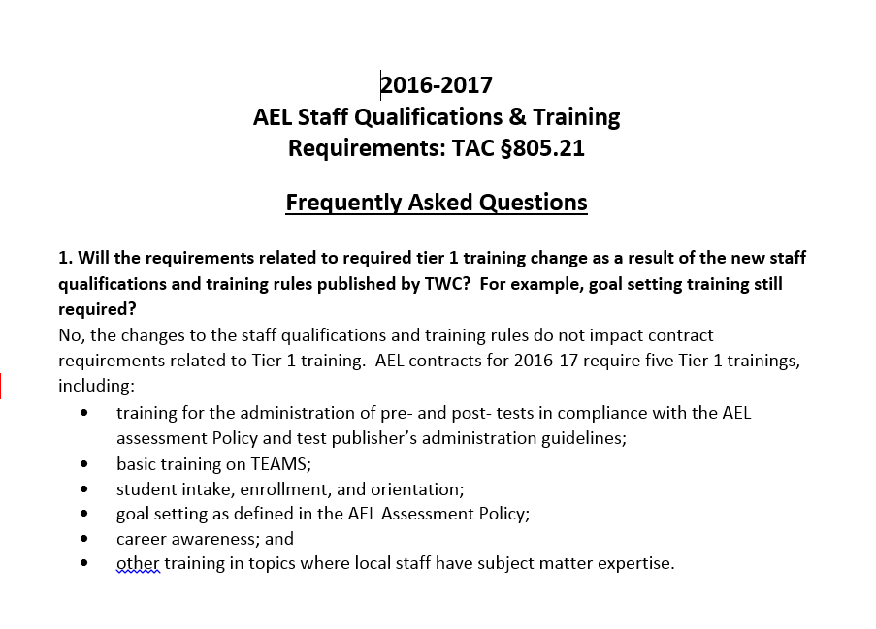
New PD Rules and Staff Qualifications
Notes:
Review FAQ’s and field questions

Slide 21
Unpacking PD Grant-specific Requirements
5.6.16.7 The Grantee is responsible for maintaining staff development records including:
  5.6.16.7.1 verification of educational credentials for each staff member;
  5.6.16.7.2 PD requirements and activity for each staff member;
    5.6.16.7.2.1 quarterly entry of PD hours for each staff member into TEAMS; and
    5.6.16.7.2.2 documentation of PD activities, to include descriptions/agendas, dates, trainers, times, and sign-in and sign-out sheets, phone/webinar attendance records, and/or computer-generated certificates of completion.
Notes:
Let’s see how this works in the PD Portal.
Demonstrate how a manager can see everyone’s transcripts

Slide 22

Overview
UPDATE:
Walk-ins will need to have a PD Portal Account and will need to register for the training session while at the training.
Notes:
Overview
Go over all buttons
Under Connect Communities – show PD Coordinator thread
Under Training Calendar – show video
Under Search for Training – Show how to “refine Search” in Search for Training

Slide 23
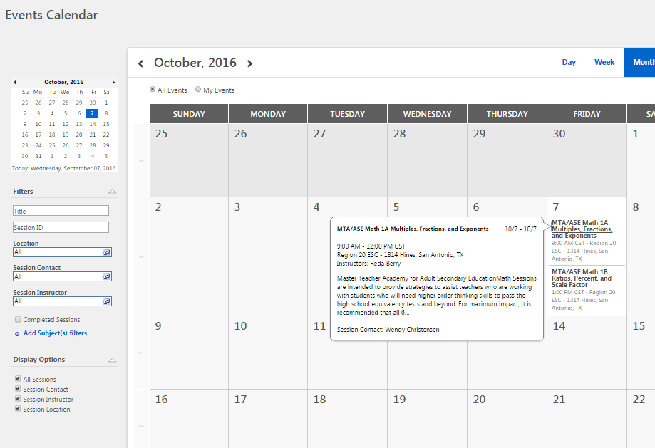
Assigning Training
Assigning Training to your Team

Slide 24
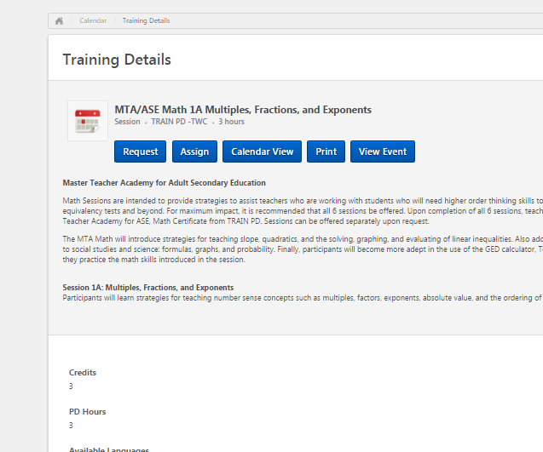
Training Details

Slide 25
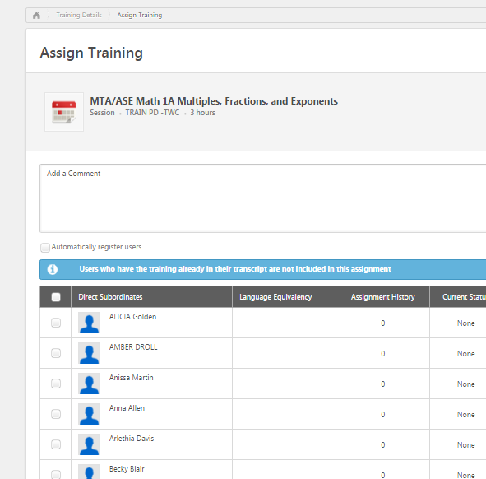
Assign Training

Slide 26
Training Workshop Confirmation
From: <pdportal@tamu.edu>
Date: September 7, 2016 at 1:05:23 PM CDT
To: <baponder@tamu.edu>
Subject: Training Workshop Confirmation
Reply-To: <pdportal@tamu.edu>
Dear Beth Ponder:
You have registered for the following training item:
Title: Effective Instruction for the Multi-level Classroom
Training Type: Session
Class Description: This interactive training focuses on appropriate lesson planning strategies, group strategies, and effective multi-level activities. It includes theory and strategies to use in teaching all subjects of the ABE/ASE to a multi-level class. Classroom management techniques, test preparation, orientation procedures, multi-sensory lesson planning, and proficiency objectives of the Texas Content standards will be presented. Participants must attend Module 1 before attending Module 2.
Training Hours: 7 Hours 0 Min
Training Credits: 6

Slide 27
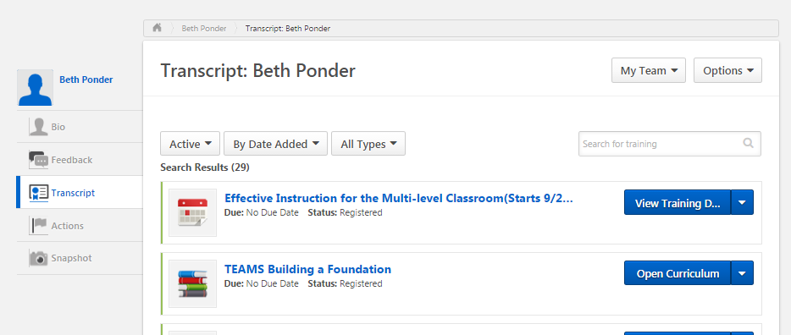
Transcript

Slide 28
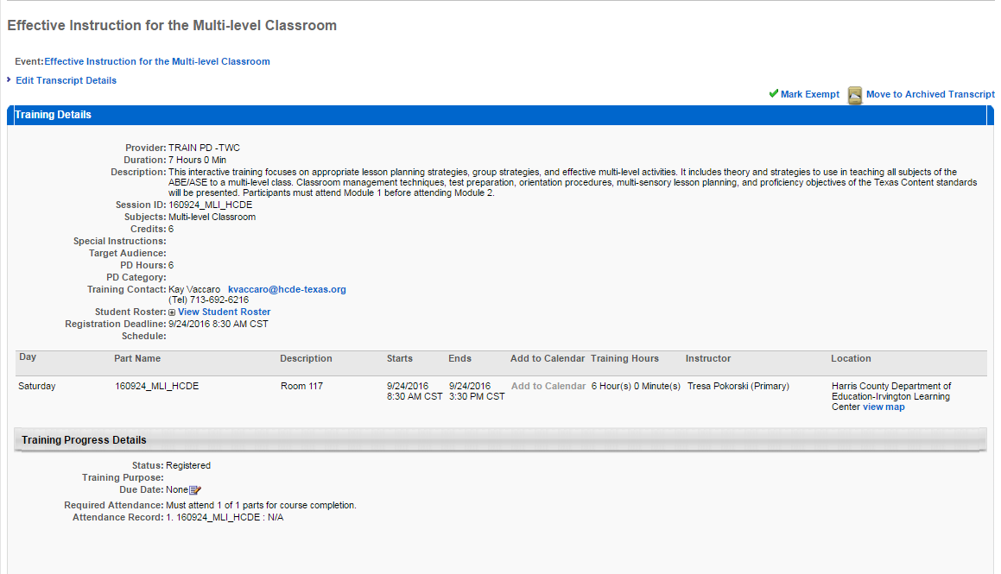
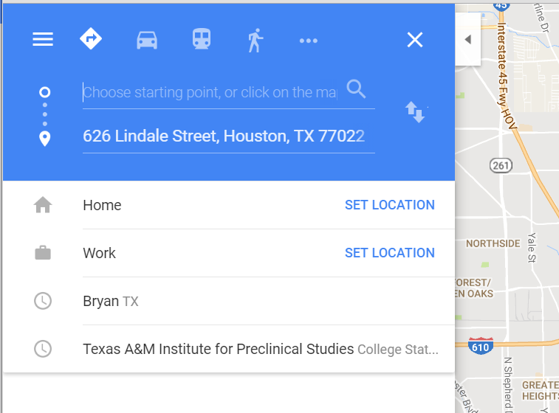
Detail Page

Slide 29

Viewing Your Team’s Transcripts
Viewing Your Team’s Transcripts
Notes:
Introduce TRANSCRIPT REPORTS

Slide 30
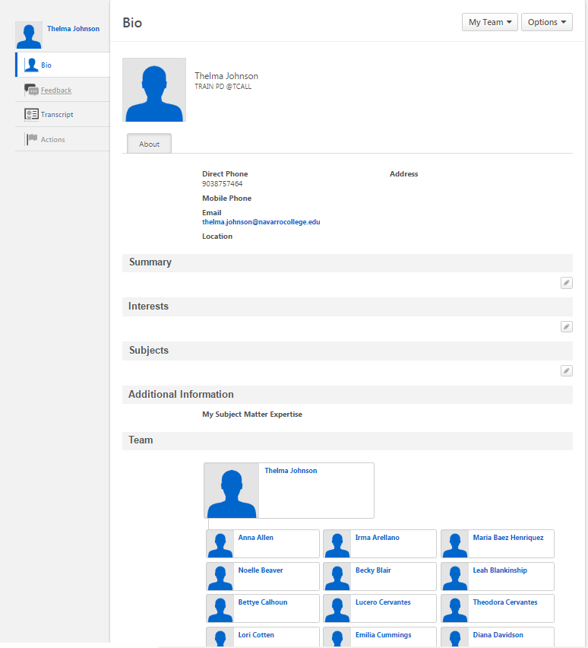
Bio

Slide 31
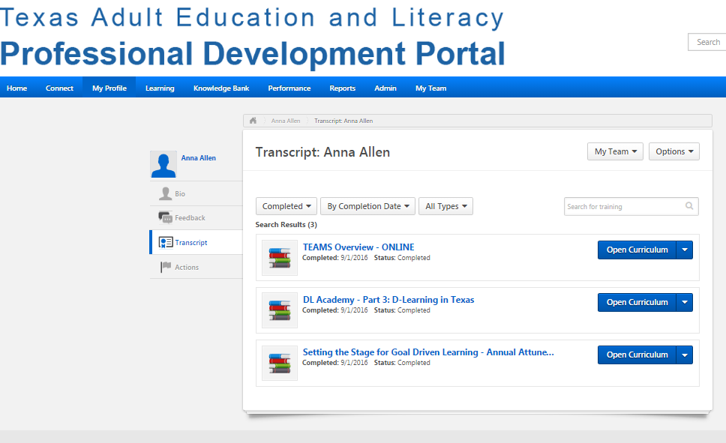
Transcript

Slide 32
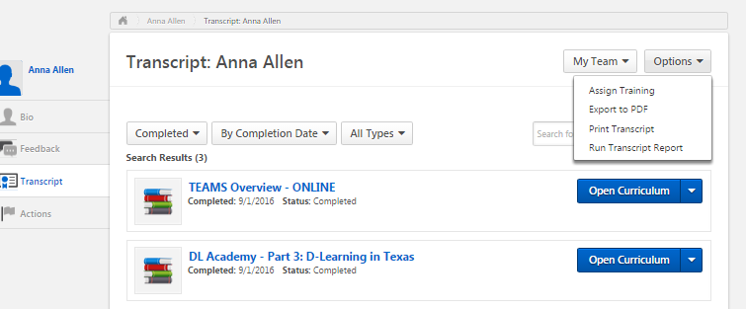
Transcript
Notes:
Get answer from Dezen on setting up team report

Slide 33

Other Portal Questions
Other Portal Questions

Slide 34
PD Coordinators can see _(whose)_ transcript
Everyone in the system’s
Only theirs
Those where they are listed in the PD Portal as “Manager.”

Slide 35
PD Coordinators can assign training to people on their team.
True
False

Slide 36
Unpacking PD Grant-specific Requirements
Bottom Line:
No PD = No Job!
5.6.16.8 Staff employed in the first quarter of a Program Year and not completing mandatory PD are not eligible to perform AEFLA grant-funded activities in the next Program Year without Agency approval.
5.6.16.9 Program Directors must participate in two (2) grants administration and technical assistance meetings coordinated by the Agency.

Slide 37

Talent Search
Looking for Tech Savvy Talent to present Tech and Tell webinars
Contract Trainer Database update: New year brings renewals. Letters going out to existing CTDB trainers inviting them to reapply
Any other great trainers who might be interested in applying?

Slide 38
Upcoming Events
Sept 22-23 AND Sept 29-30
TWSVR (Texas Workforce Solution Vocational Rehabilitation) Tech and Tell webinars (open to anyone)
October
Conflict Resolution and Dealing with Difficult People – Dr. Derek Crews (open to all Program Managers) date and time TBD
No date set yet
TABE Clas-e Overview Webinar (open to anyone)
Request from Dr. Glenda Rose – Campus Tech training
Notes:
Glenda: Early next year, TRAIN PD will offer a Program Technology Specialist Academy for individuals identified by their programs who will be able to fill this role.

Slide 39

Final Questions
Thank you for
being here!

